Slide 1

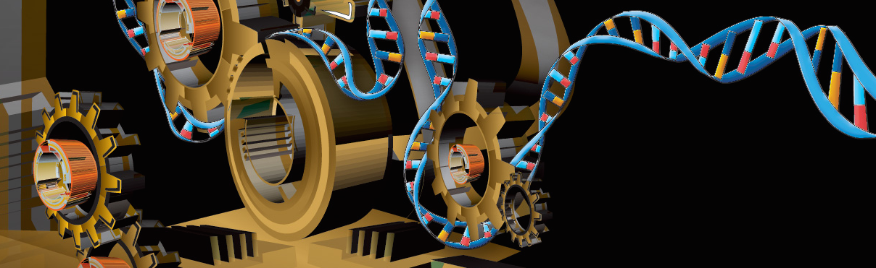
Exploring genome-wide organization of chromatin structure by ChIP-seq
Alon Goren
Assistant Professor
Department of Medicine

Slide 2
Get an interactive node
qsub -I -l nodes=1:ppn=8 -l walltime=4:00:00 -q hotel

Slide 3
CUT&RUN
(Cleavage under targets and release using nuclease)
Skene, Henikoff & Henikoff Nature Protocols 2018

Slide 4
Major HMs:
H3K4me1 – Enhancers (active/poised)
H3K4me2 – Promoters & Enhancers (active/poised)
H3K4me3 – Promoters (active)
H3K9me3 – Heterochromatin
H3K27ac – Promoters & Enhancers (active/poised)
H3K27me3 – Promoters (active/poised)
H3K36me3 – transcribed genes

Slide 5
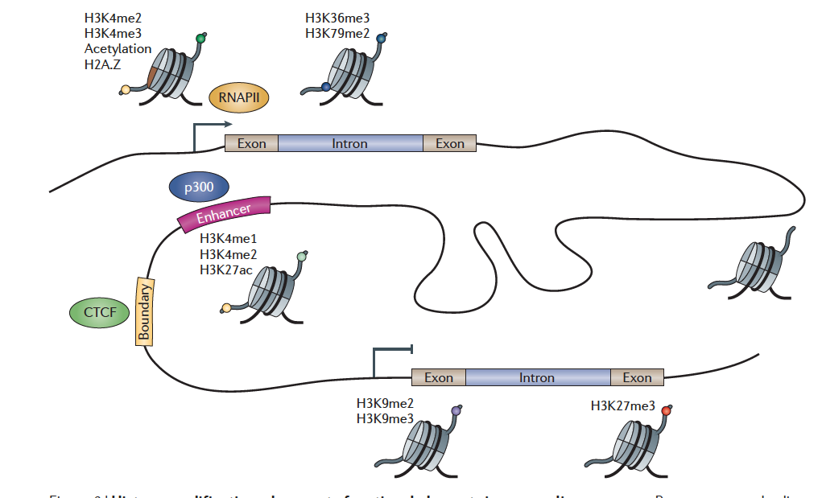
Histone modifications demarcate functional elements
Zhou, Goren & Bernstein Nature Reviews Genetics 2010

